Slide 1
Oplæg for gymnasielærere på programmeringskursus
17. maj 2024
Informatik
Teknologiforståelse | Fagligt samspil | GAI
Michael E. Caspersen
Direktør, It-vest – samarbejdende universiteter
Adjungeret professor, Institut for Datalogi, Aarhus Universitet
mec@it-vest.dk

Slide 2
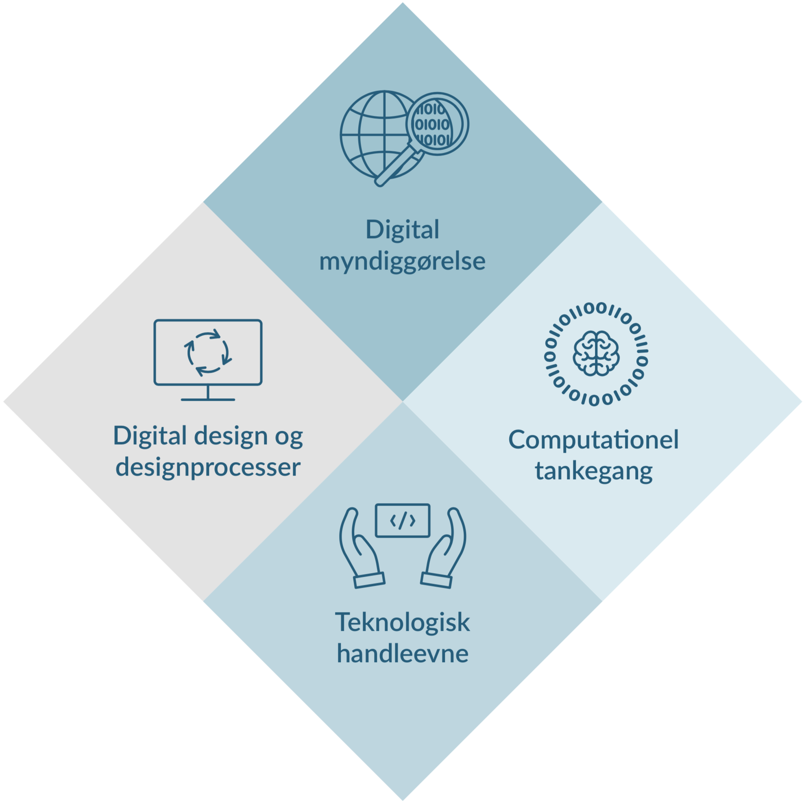
Teknologi- forståelse

Slide 3

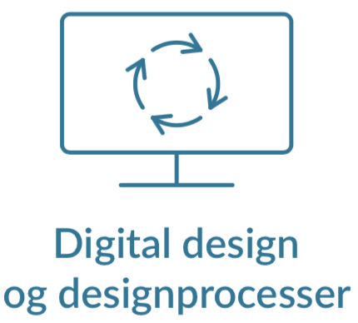
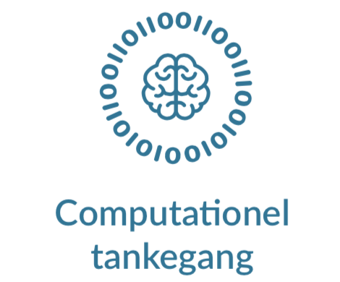
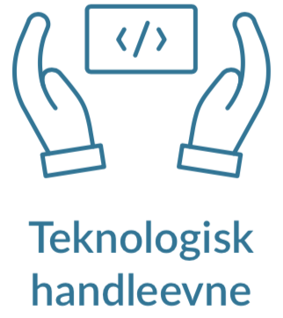
De fire kompetenceområder
Digital myndiggørelse
Kritisk, refleksiv og konstruktiv undersøgelse og forståelse af digitale artefakters muligheder og konsekvenser.
Analyse af teknologi, formål og brug | Konsekvensvurdering | Redesign
Digital design og designprocesser
Tilrettelæggelse og gennemførelse af iterative designprocesser under hensyntagen til
fremtid brug.
Rammesættelse| Idégenerering | Konstruktion | Argumentation og introspektion
Computationel tankegang
Analyse, modellering og strukturering af data og dataprocesser med henblik på automatisk udførelse af en computer.
Data | Algoritmer | Strukturering | Modellering
Teknologisk handleevne
“Mestring” af digitale teknologier (computersystemer, netværk og sikkerhed) og tilhørende sprog samt programmering.
Programmering | Computersystemer | Netværk | Sikkerhed
Notes:
The Danish Informatics curriculum for primary and lower secondary school consists of four competence areas:
- Digital empowerment
- Digital design and design processes
- Computational thinking and modelling, and
- Technological knowledge and skills.
The two latter encompass traditional computing subjects, while the two former are less standard in Informatics curricula – if present at all.
Inclusion of Digital design and design processes recognise the bipartite nature of all computation that is directed at purposes in the real world.
Thus, we embrace both problem domain and solution domain – the entire bipartite system. Both the software machine and the physical (or imaginary) world whose behaviour it governs.
This is not generally embraced in curricula for computing in school. The focus on design process is inspired by the Scandinavian school of Participatory Design, which originated in the 1960s and 1970s, and by Donald Schön’s philosophy of design as a reflective practice from the 1980s. The particular notion of problem framing and reframing are essential parts of this and is also inspired by the seminal work of British computer scientist Michael Jackson in the 1990s.
Another unique – I think – component of our curriculum is Digital empowerment, which represents the ability to analyse and evaluate digital artefacts with a focus on intention and use through a critical, reflexive and constructive examination and understanding of consequences and possibilities of a digital artefact.
This is for digital artefacts what literature analysis is for novels, but with the additional liberating component of reframing and redesign – realising that digital artefacts are human-made and could have been designed differently if other perspectives had been applied.

Slide 4
Computationel modellering af et problemdomæne
Begreber og brugssituationer
Digital
teknologi
Computationel
modellering
Analyse og abstraktion
Design og konstruktion
Værdi gennem brug
og fortolkning
Fænomener og
komplekse problemer
Digitale
artefakter
Problemdomæne
Computationelt modelsystem
Notes:
The four competence areas constitute a holistic approach to Informatics, which I will describe in terms of this model of computational modelling. ;-)
The real or an imaginary world is populated with phenomena and activities, which – through analysis and abstraction – can be understood in terms of concepts and use cases.
Through computational modelling, these can be prioritised, structured and modelled for computational representation. Through design and construction using digital technology, new digital artefacts can be developed to manipulate and transform these representations into something, which hopefully provides value through interpretation and use back in the real world.

Slide 5
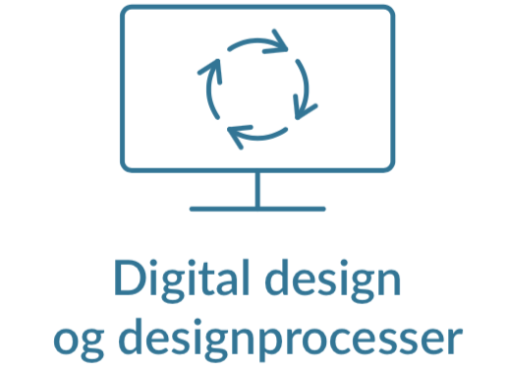
Teknologiforståelse
Begreber og brugssituationer
Digital
teknologi
Computationel
modellering
Analyse og abstraktion
Design og konstruktion
Værdi gennem brug
og fortolkning
Fænomener og
komplekse problemer
Digitale
artefakter
Problemdomæne
Computationelt modelsystem
Notes:
The four competence areas maps – more or less 1-1 – to the four processes in the model.
[Shift to 28a – animation]
Digital design and design processes covers primarily activities related to the problem domain.
[Shift to 28b – animation]
Computational thinking and modelling maps to the process going from problem domain to the computational model system.
[Shift to 28c – animation]
Technological knowledge and skills provide competences to design and construct digital artefacts
[Shift to 28d – animation]
Digital empowerment relates to the process back from the computational model system to the problem domain.
Not only does the four competence areas constitute a nice, full circle. They also mutually strengthen each other.
Analytical competences provided by Digital empowerment will strengthen the three other competence areas. And vice versa: if you actually know how to build digital artefacts, your critical and constructive analysis can become much richer and deeper.

Slide 6
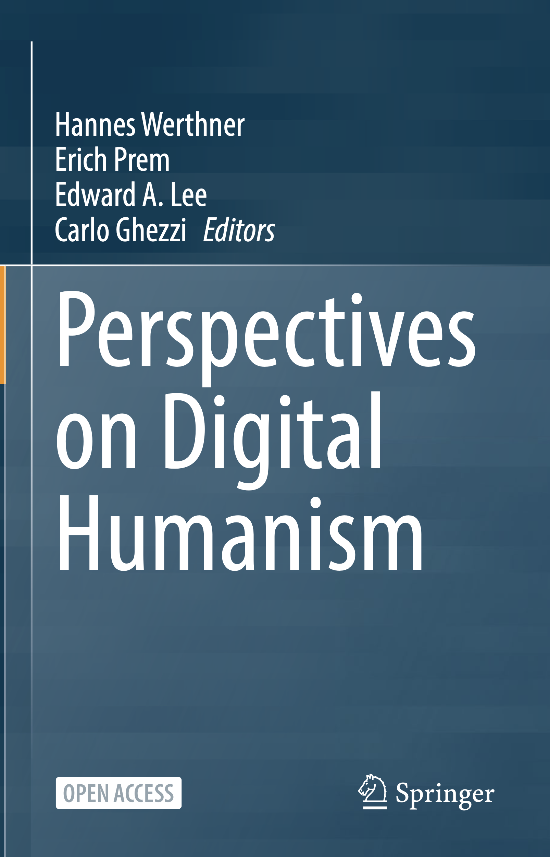
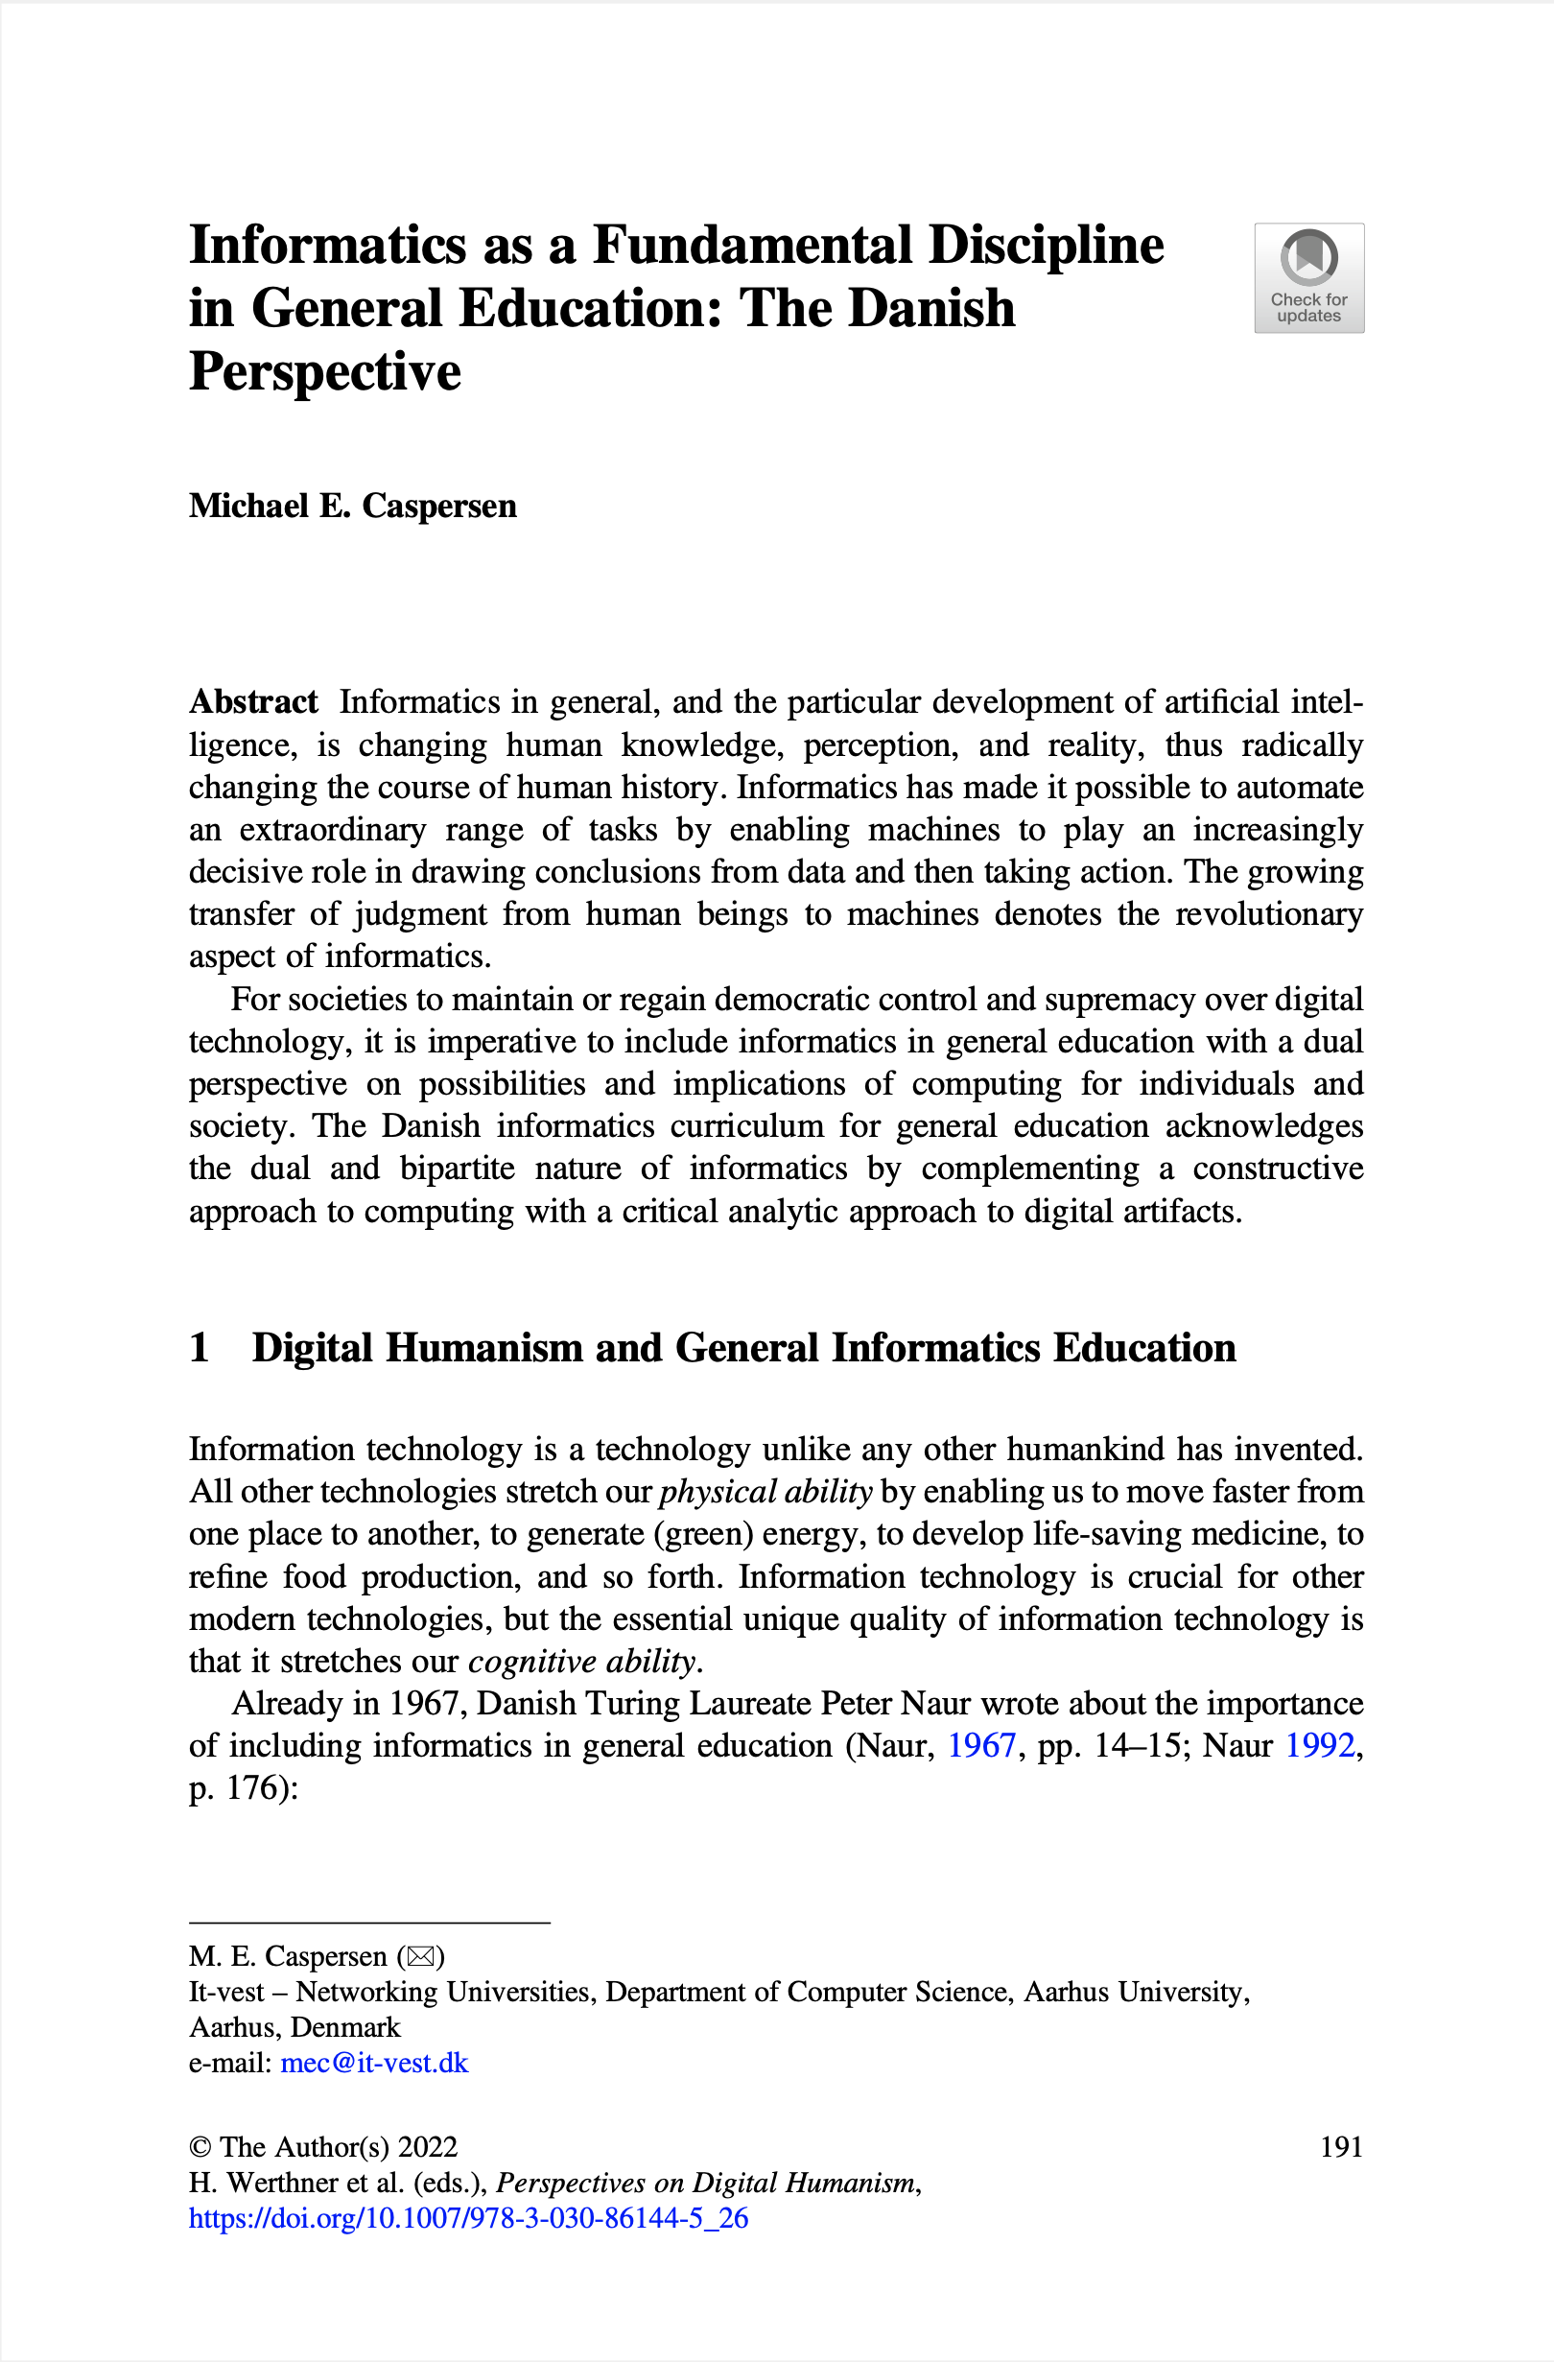
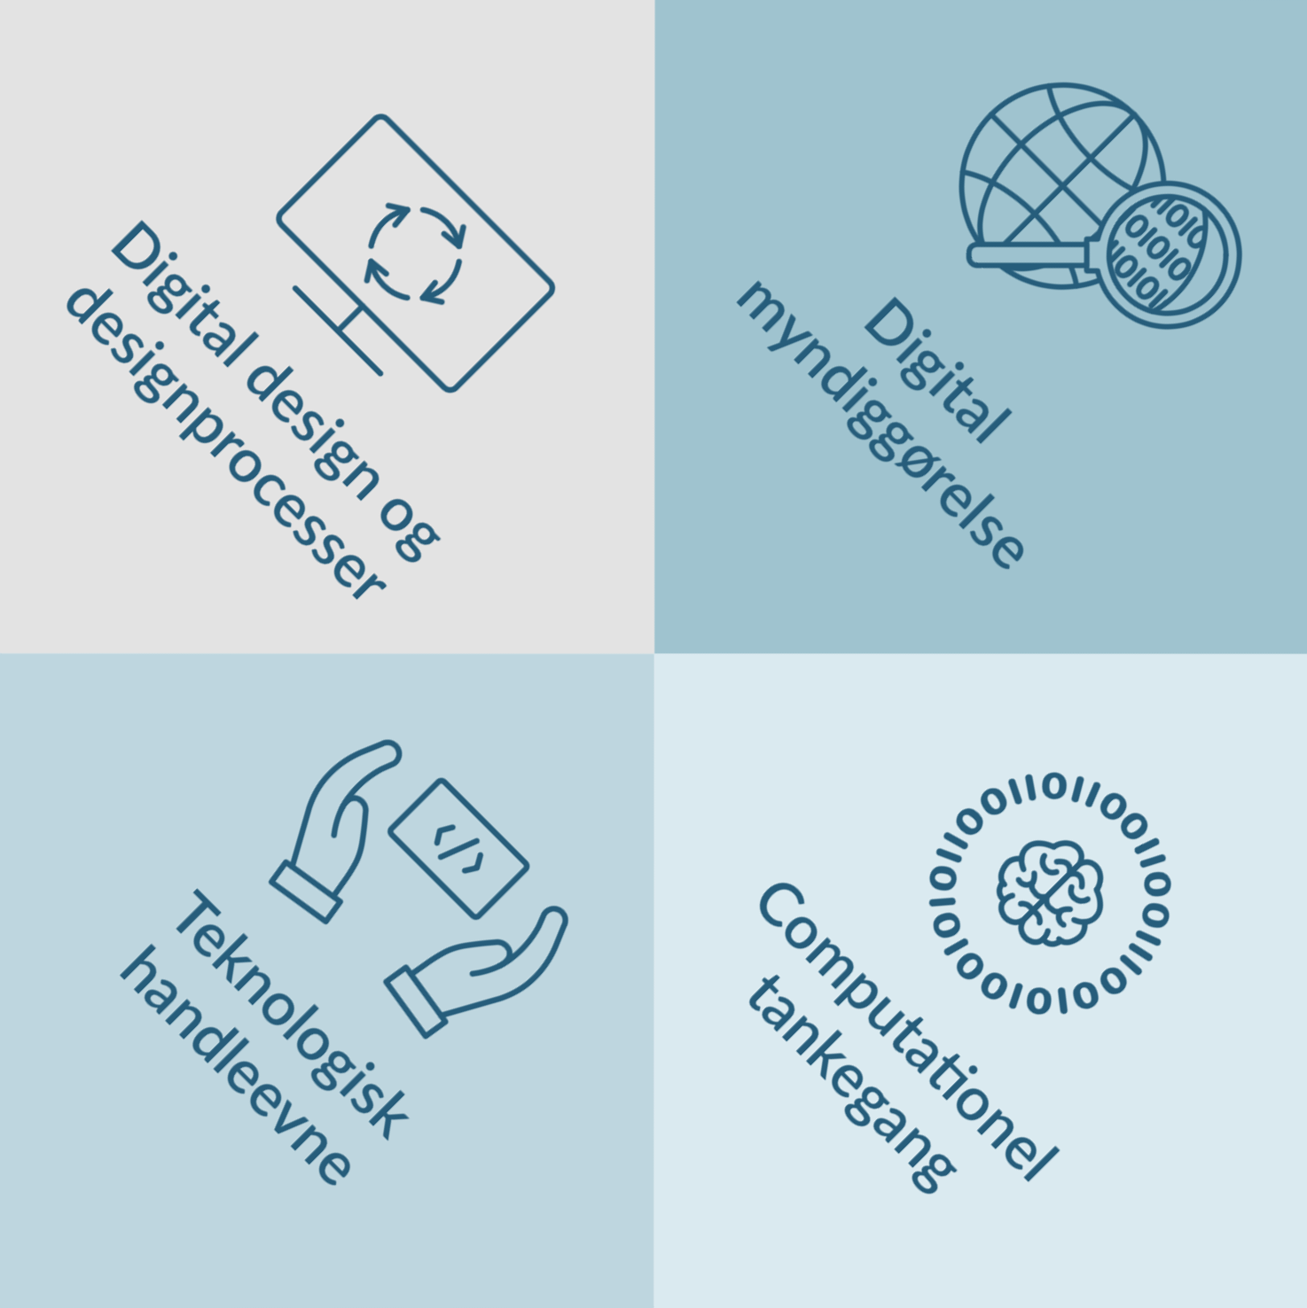
Den danske model
Informatik
på ungdomsuddannelserne
Forsøgsfag i folkeskolen
(2019-2021)
En begrebsmæssig og praktisk tilgang med et teknisk og et humant/socialt perspektiv
Notes:
Dette kapitel beskriver den danske model for informatik/teknologiforståelse i almen uddannelse og dermed, hvad I kan forvente at jeres studerende kommer med af kompetencer om føje år.

Slide 7

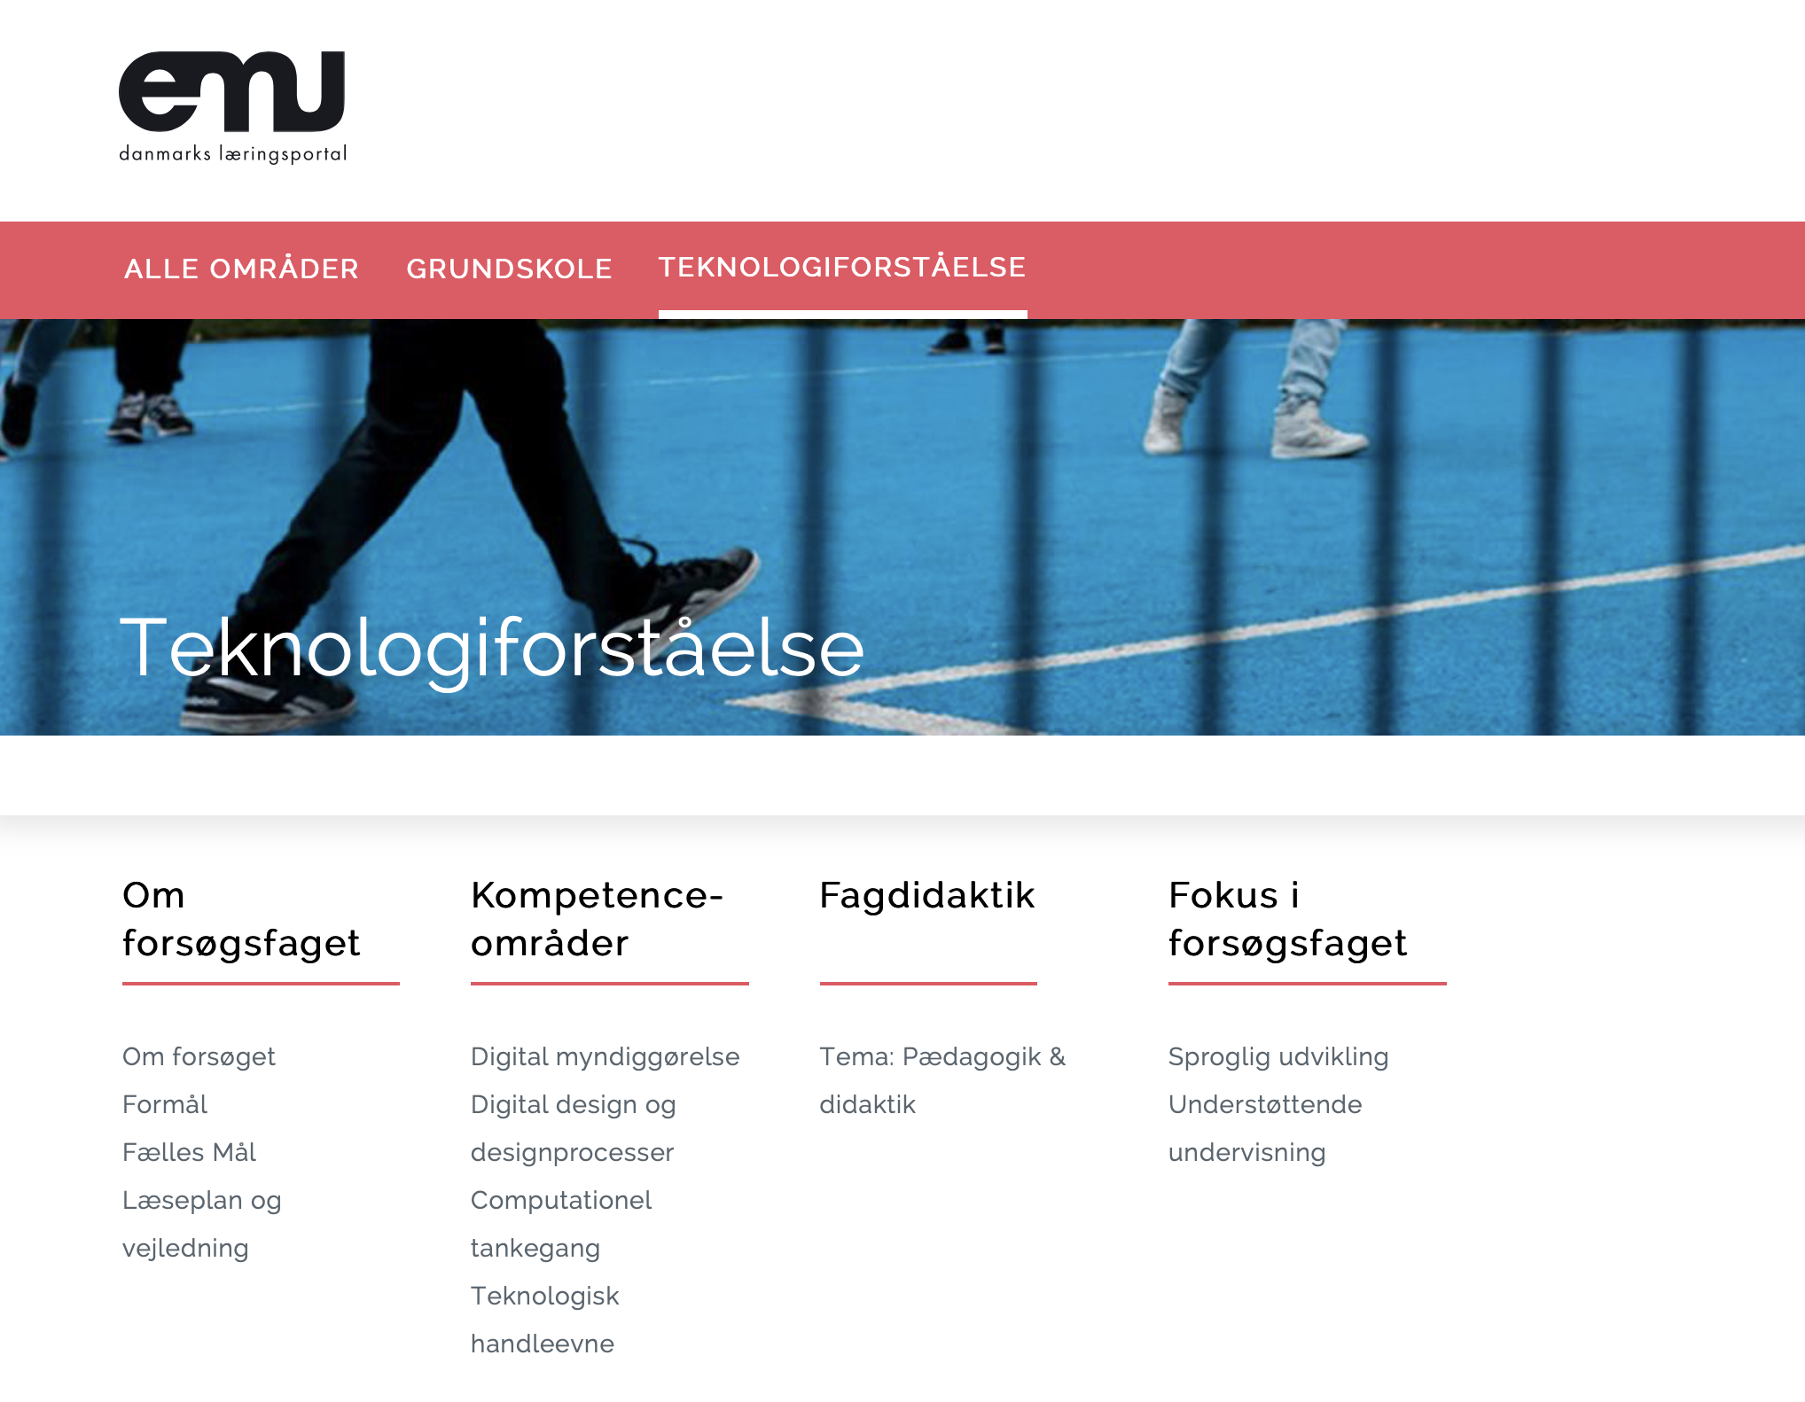

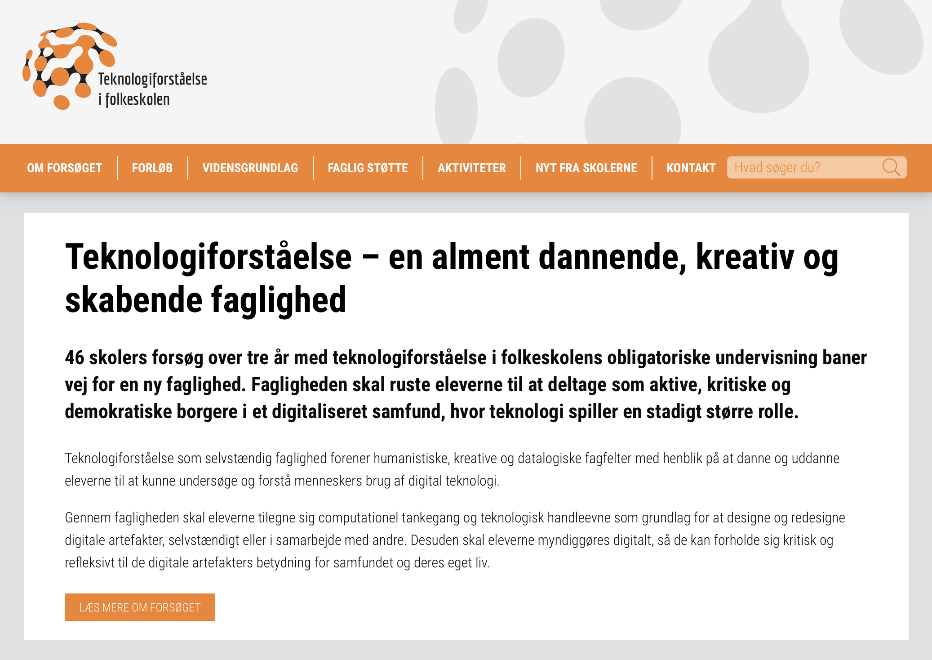

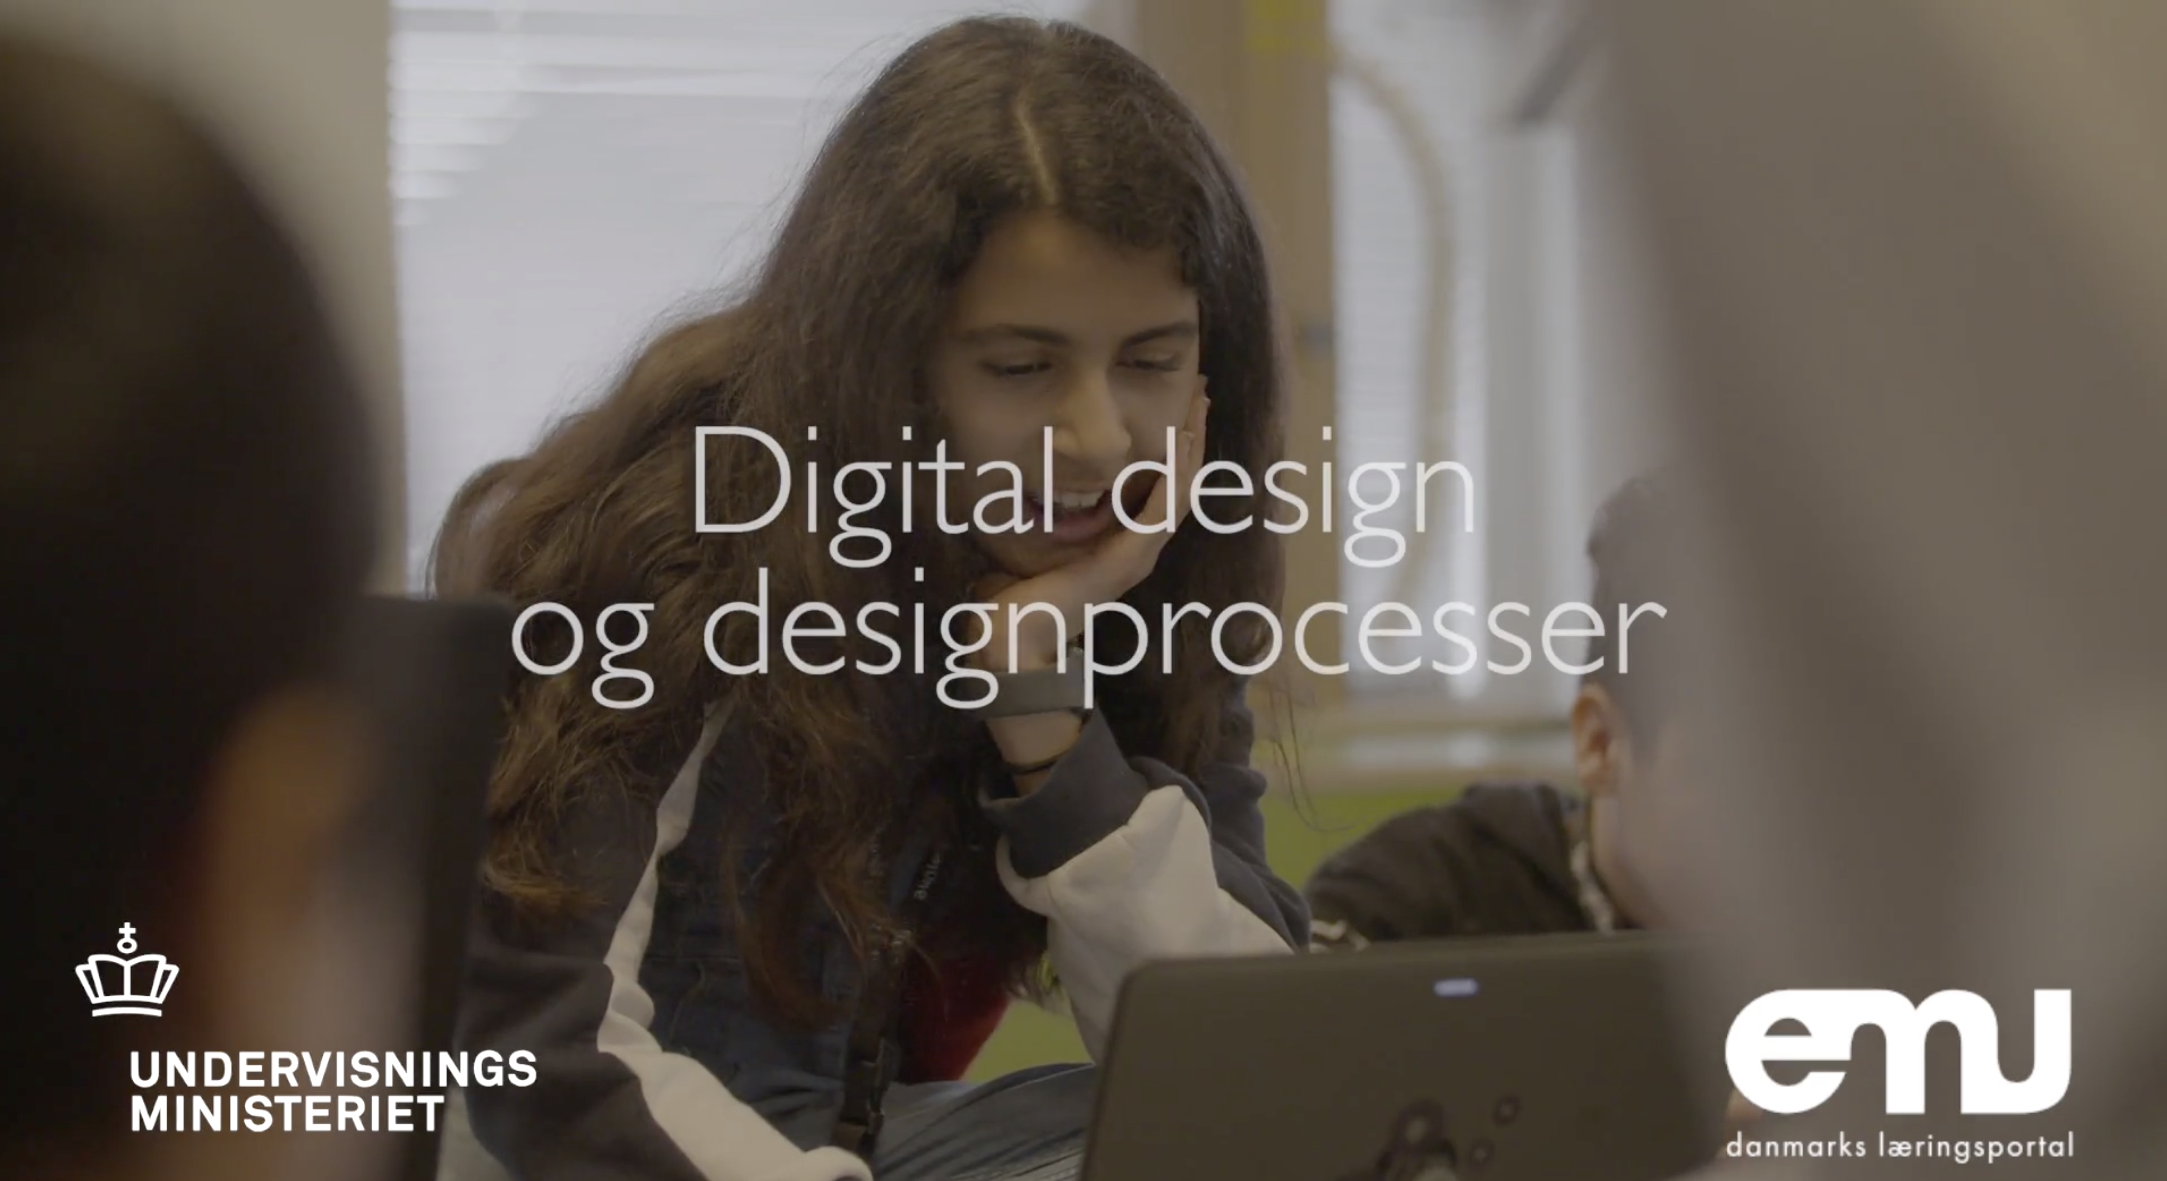
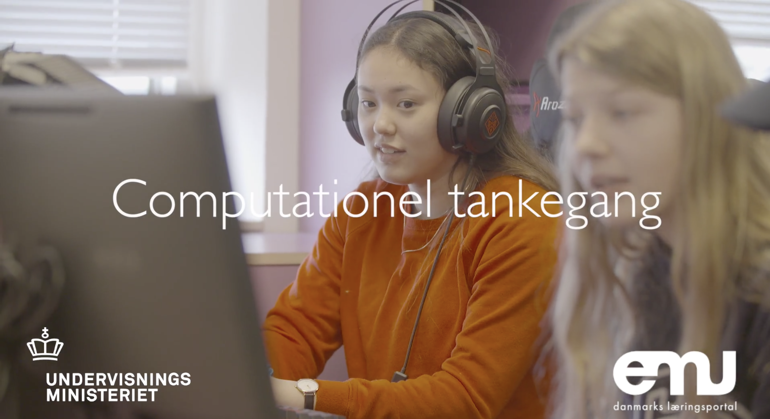

Ressourcer om teknologiforståelse

Slide 8
Afprøvning og evaluering af to/tre modeller
Afprøvning som selvstændigt fag
Politisk afgørelse
forligskredsen
Fagudvikling og formulering af
Fælles Mål
Kombi-model (afprøves ikke, men evalueres!)
Afprøvning i eksisterende fag
Evaluering
2018
2019-2021
2021 ... 2024 (?)

